Slide 1

PROJECT ARCHITECTURE DIAGRAM

Slide 2
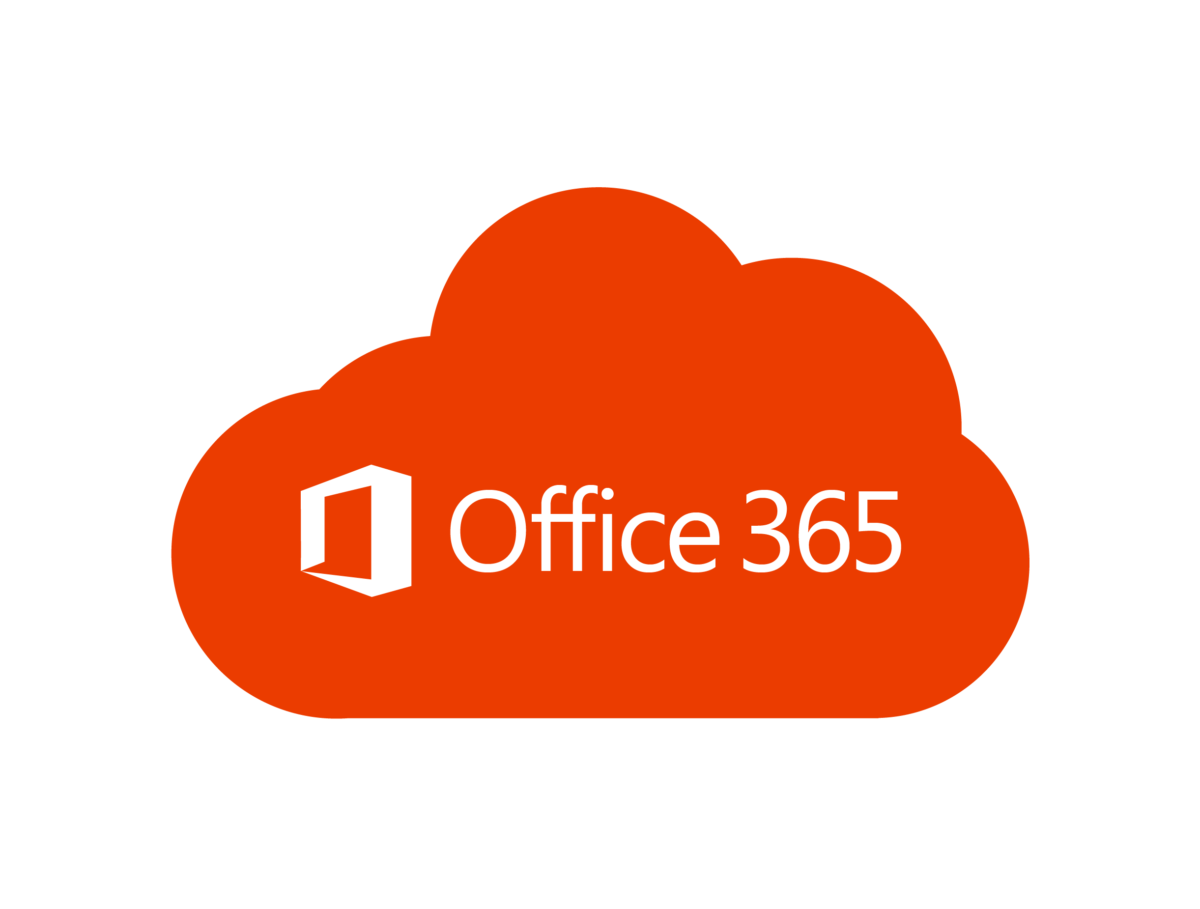



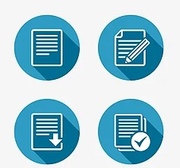
ARCHITECTURE
3
5
1
2
4
Important Points
Data Collected From Office 365 User.
Data Provided by the Office 365 User Uploaded and App Created Using PowerApps
User Can Enter and View the Details .
User Can Edit and Delete the Details .
Final Data Stored in SharePoint

